Slide 1

Machine Learning Hackathon CG 2022
Team Name- Abnormal Distribution
Team Leader Name- Shwethaa Rajagopalan
Team Leader Email Address- rshwethaaee055@gmail.com

Slide 2
Brief description of the problem at hand:
Given various features of a website, develop a model to identify as legitimate/phishing.

Slide 3
Solution proposed and description:
Use of Random Forest algorithm with hyperparameters
'criterion': 'gini'
'max_depth': 35
'max_features': 'sqrt'
'n_estimators': 100
Reasons for choosing algorithm:
Not computationally intensive
Relatively less complex

Slide 4
Technology/Tool Stack Used:
Python version: 3.7.13
Scikit-learn 1.0.2 (For model development)
Google Colab runtime
Pandas

Slide 5
Approach:
Step 1: Data preprocessing
--No null values
--No outliers
Step 2: Data Analysis
--
Step 3: Model
-- Splitting data (80-20 stratified split due to unbalanced data)
-- Trying multiple algorithms on default hyperparameter values
-- Hyperparameter tuning

Slide 6
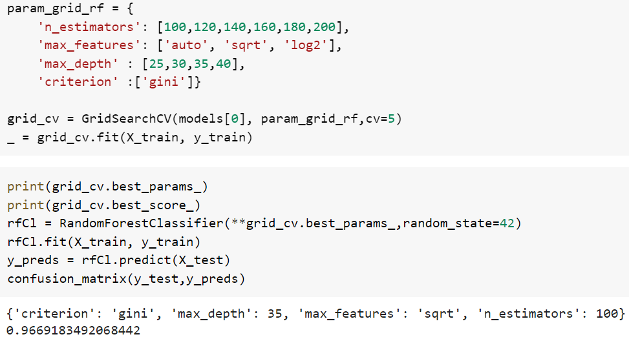
Execution Demo(Video/Screenshots) of the solution:

Slide 7
Source code as ZIP or Github URL:
https://github.com/shwethaar/HPE-ML-Hackathon

Slide 8
THANK YOU

